Slide 1
LECTURE -7
Introduction to Machine Learning
Course Instructor
Engr. Naina Said

Slide 2

Traditional Programming
CSE-422: Data Analytics

Slide 3
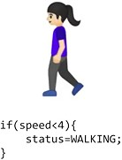
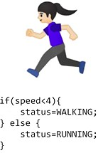
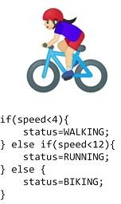

Example : Traditional Programming Paradigm
CSE-422: Data Analytics

Slide 4
The Machine Learning Paradigm
CSE-422: Data Analytics
Traditional programming requires rules, and the rules are difficult to figure out in complex problems.
Instead of writing explicit rules, provide the machine with labeled examples and let it figure out the rules itself.
In machine learning, we provide the data (input features) and the answers (labels) and the ML algorithm finds the rules which relate these two.

Slide 5

The ML Paradigm
CSE-422: Data Analytics

Slide 6
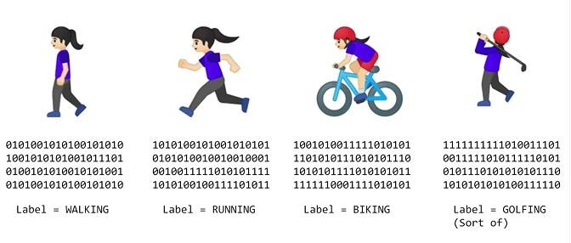
Activity Recognition : Machine Learning Way
CSE-422: Data Analytics

Slide 7
What is ML?
CSE-422: Data Analytics
Arthur Samuel (1959): Machine Learning is the field of study that gives the computer the ability to learn without being explicitly programmed.
Tom Mitchell (1998): a computer program is said to learn from experience E with respect to some class of tasks T and performance measure P, if its performance at tasks in T, as measured by P, improves with experience E.
Experience here refers to data.

Slide 8
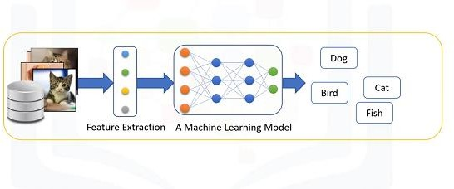
How ML works?
CSE-422: Data Analytics

Slide 9
Why ML?
CSE-422: Data Analytics
There are a number of applications of machine learning.
Face, speech, handwritten character recognition
Fraud detection (e.g., credit card)
Recommender problems (e.g., which movies/products etc you’d like)
Annotation of biological sequences, molecules, or assays.
Market prediction (e.g., stock/house prices)
Finding errors in computer programs, computer security defense applications etc.

Slide 10
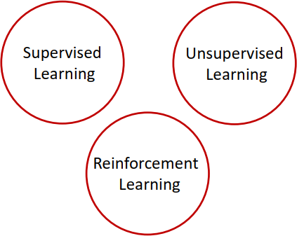
Types of Machine Learning
CSE-422: Data Analytics

Slide 11
Supervised Learning
CSE-422: Data Analytics
Supervised Learning ->To observe and direct the execution of a task.
We will be supervising a ML model for some task (e.g. determining whether the cancer is benign or malignant).
How to supervise ML model?
We teach the model.
It then uses this knowledge to predict unknown or future values.

Slide 12
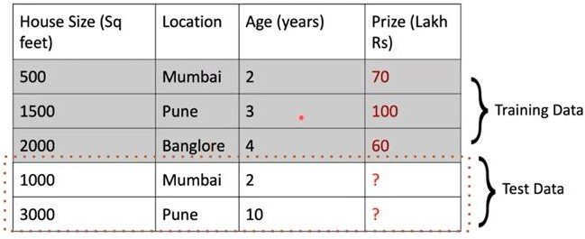
Teaching a model with Labeled Data
CSE-422: Data Analytics

Slide 13
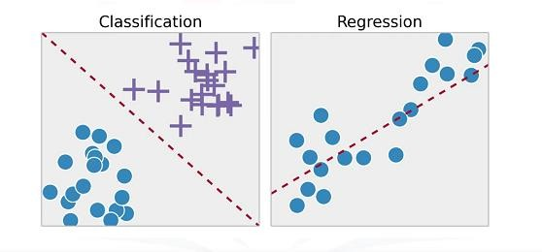
Types of Supervised Learning
CSE-422: Data Analytics

Slide 14
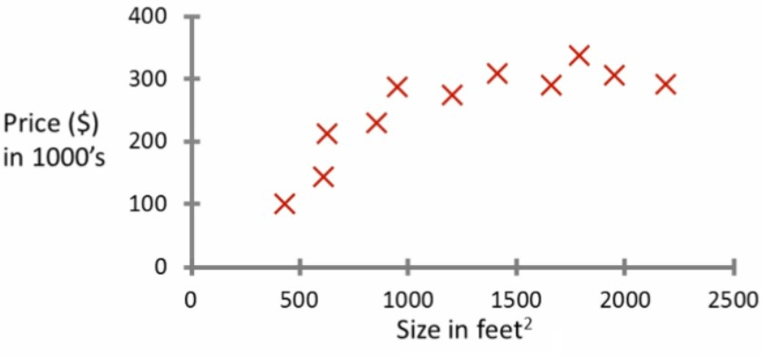
Regression
CSE-422: Data Analytics
Process of predicting continuous values.
Probably the most common problem type in machine learning.
Example : Predicting House Price.

Slide 15
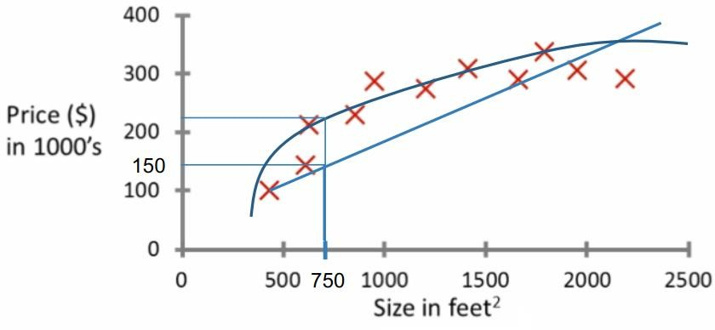
Regression (2)
CSE-422: Data Analytics
What is the price of a house whose size is 750 sq. feet?

Slide 16
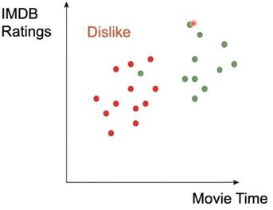
Classification
CSE-422: Data Analytics
Process of predicting discrete class labels or categories.
E.g. Will a user like or dislike a movie based on IMDB ratings and movie time?

Slide 17
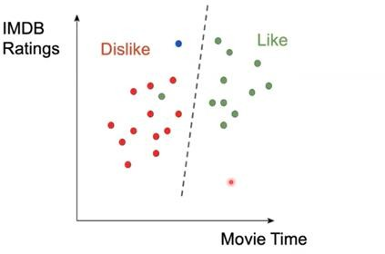
Classification (2)
CSE-422: Data Analytics

Slide 18
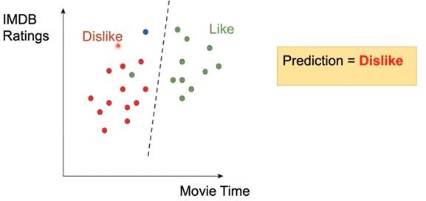
Classification (3)
CSE-422: Data Analytics

Slide 19
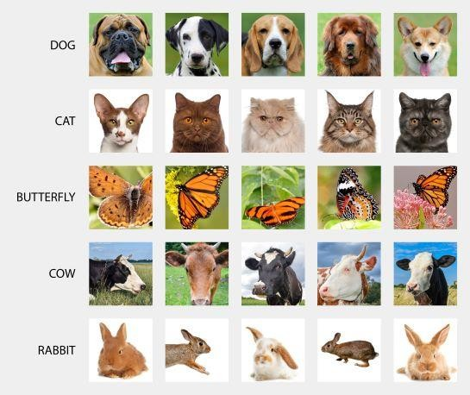
Supervised Learning in Computer Vision
CSE-422: Data Analytics
Image Classification
𝑥 = raw pixels of the image, 𝑦 = the main object

Slide 20
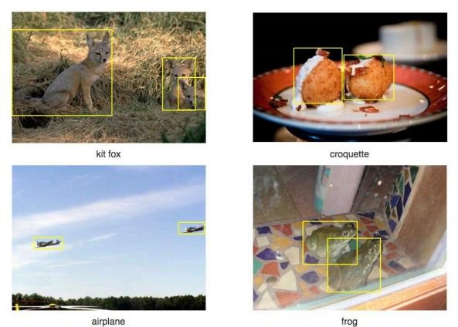
Supervised Learning in Computer Vision
CSE-422: Data Analytics
Object Localization and Detection
𝑥 = raw pixels of the image, 𝑦 = the bounding boxes

Slide 21

Supervised Learning in Natural Language Processing
CSE-422: Data Analytics

Slide 22
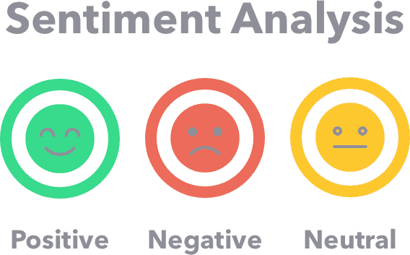
Supervised Learning in Natural Language Processing
CSE-422: Data Analytics

Slide 23
Question
CSE-422: Data Analytics
You are running a company, and you want to develop learning algorithm to address each of two problems
You have a large inventory of identical items. You want to predict how many of these items will sell over the next 3 months.
You’d like software to examine individual customer accounts, and for each account decide if it has been hacked/compromised.
Should you treat these as classification or as regression problems?

Slide 24
Unsupervised Learning
CSE-422: Data Analytics
We do not supervise the ML model.
We let the model discover information for grouping which might be invisible to human eye
Trains on unlabeled data.

Slide 25
Unsupervised Learning (2)
CSE-422: Data Analytics
Given
A data set
No information about the structure or output
Output
Find structure in the data
Unsupervised Learning Algorithm
Decides on the structure of the data

Slide 26
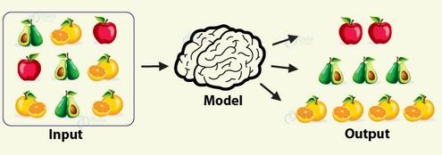
Unsupervised Learning (3)
CSE-422: Data Analytics

Slide 27
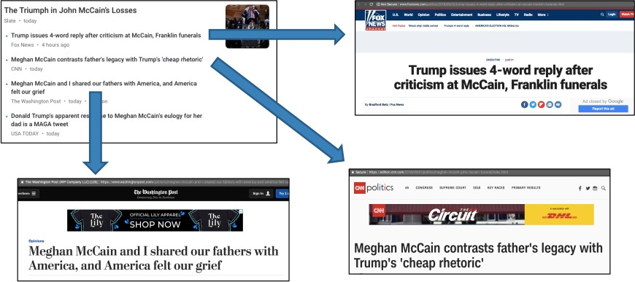
Unsupervised Learning (4)
CSE-422: Data Analytics
Groups news stories into cohesive groups

Slide 28
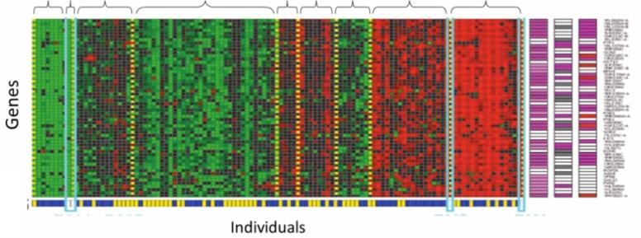
Unsupervised Learning (5)
CSE-422: Data Analytics
Genomics
Microarray Data
Have a group of individuals
On each measure expression of a gene
Run algorithm to cluster individuals into types of people

Slide 29
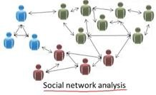
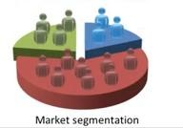
Unsupervised Learning (6)
CSE-422: Data Analytics

Slide 30
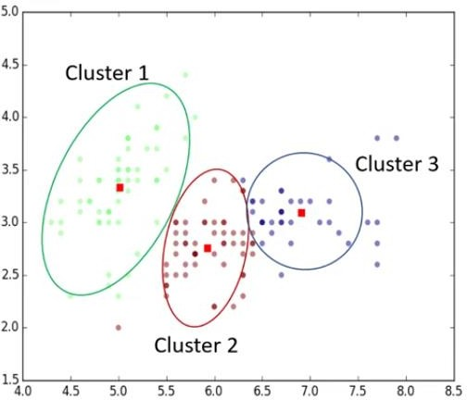
Unsupervised Learning (7)
CSE-422: Data Analytics
Most popular unsupervised learning technique.
Grouping of data points that are somehow similar.

Slide 31
Unsupervised Learning (7)
CSE-422: Data Analytics
Of the following examples, which would you address using an unsupervised learning algorithm?
Given email as spam/not-spam, learn a spam filter.
Given a set of new articles found on the web, group them into set of articles about the same story.
Given a database of customer data, automatically discover market segments and group customers into different market segments.
Given a data set of patients diagnosed as either having diabetes or not, learn to classify new patients as having diabetes or not.

Slide 32
Assignment
CSE-422: Data Analytics
What is reinforcement learning?
What are its typical applications?

Slide 33
Matlab
Python
Scikit learn.
Numpy
Matplotlib
Tensorflow (deep learning)
Anaconda

Slide 34
Acknowledgment
CSE-422: Data Analytics
Material presented in these slides is obtained from Prof. Andrew Ng course on Machine Learning as well as other miscellaneous online and offline resources.

